Slide 1

UNIVERSITY INSTITUTE OF ENGINEERING
COMPUTER SCIENCE ENGINEERING
Computer Vision (CST-422)
Prepared By : Payal Thakur(E12720)
Topic: Object Detection With Machine Learning
DISCOVER . LEARN . EMPOWER

Slide 2
Object Detection With Machine Learning
Object detection is a computer vision technique for locating instances of objects in images or videos.
Object detection algorithms typically leverage machine learning or deep learning to produce meaningful results.
When humans look at images or video, we can recognize and locate objects of interest within a matter of moments.
The goal of object detection is to replicate this intelligence using a computer.

Slide 3
Why Object Detection Matters
Object detection is a key technology behind advanced driver assistance systems (ADAS) that enable cars to detect driving lanes or perform pedestrian detection to improve road safety.
Object detection is also useful in applications such as video surveillance or image retrieval systems.

Slide 4
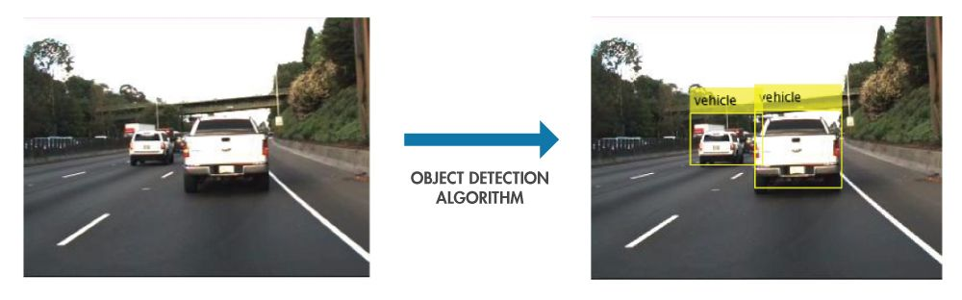
Why Object Detection Matters

Slide 5
Object Detection vs Object Recognition vs Image Segmentation
Object Recognition:
Object recognition is the technique of identifying the object present in images and videos.
It is one of the most important applications of machine learning and deep learning.
The goal of this field is to teach machines to understand (recognize) the content of an image just like humans do.

Slide 6
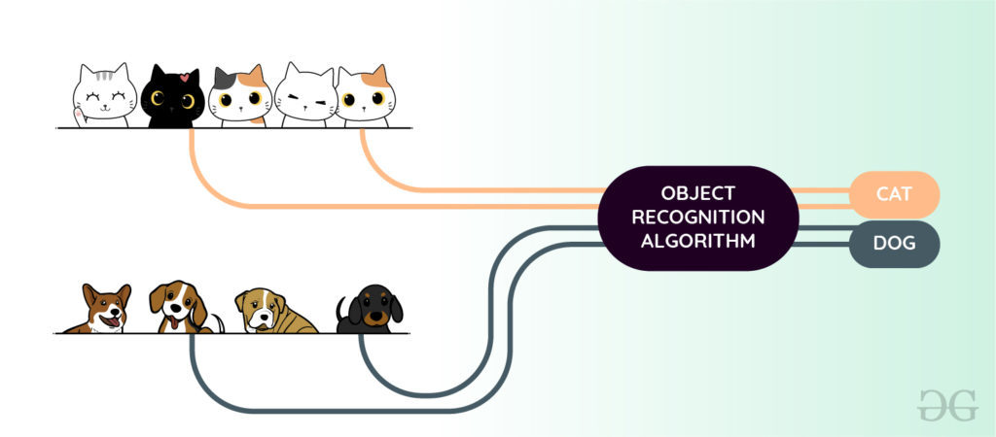

Slide 7
Object Recognition Using Machine Learning
HOG (Histogram of oriented Gradients) feature Extractor and SVM (Support Vector Machine) model: It is a state-of-the-art method for object detection. It takes histogram descriptors of both positive ( images that contain objects) and negative (images that does not contain objects) samples and trains our SVM model on that.
Bag of features model: Just like bag of words considers document as an orderless collection of words, this approach also represents an image as an orderless collection of image features. Examples of this are SIFT, MSER, etc.

Slide 8
Viola-Jones algorithm: This algorithm is widely used for face detection in the image or real-time. It performs Haar-like feature extraction from the image. This generates a large number of features. These features are then passed into a boosting classifier. This generates a cascade of the boosted classifier to perform image detection. An image needs to pass to each of the classifiers to generate a positive (face found) result. The advantage of Viola-Jones is that it has a detection time of 2 fps which can be used in a real-time face recognition system.

Slide 9
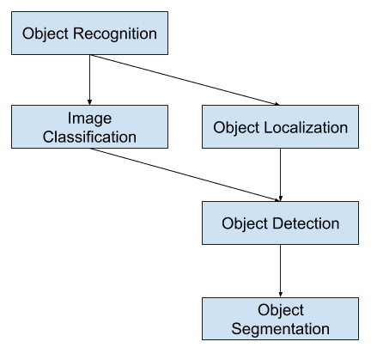

Slide 10
Image Classification: In Image classification, it takes an image as an input and outputs the classification label of that image with some metric (probability, loss, accuracy, etc).
For Example: An image of a cat can be classified as a class label “cat” or an image of Dog can be classified as a class label “dog” with some probability.Predict the type or class of an object in an image.
Input: An image with a single object, such as a photograph.
Output: A class label (e.g. one or more integers that are mapped to class labels).

Slide 11
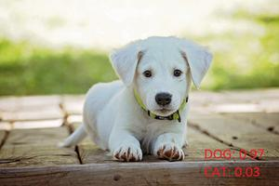

Slide 12
Object Localization: This algorithm locates the presence of an object in the image and represents it with a bounding box. It takes an image as input and outputs the location of the bounding box in the form of (position, height, and width).
Locate the presence of objects in an image and indicate their location with a bounding box.
Input: An image with one or more objects, such as a photograph.
Output: One or more bounding boxes (e.g. defined by a point, width, and height).

Slide 13
Object Detection: Object Detection algorithms act as a combination of image classification and object localization.
It takes an image as input and produces one or more bounding boxes with the class label attached to each bounding box.
These algorithms are capable enough to deal with multi-class classification and localization as well as to deal with the objects with multiple occurrences.
Locate the presence of objects with a bounding box and types or classes of the located objects in an image.
Input: An image with one or more objects, such as a photograph.
Output: One or more bounding boxes (e.g. defined by a point, width, and height), and a class label for each bounding box.

Slide 14
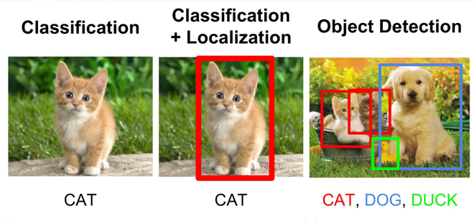

Slide 15
Challenges of Object Detection:
In object detection, the bounding boxes are always rectangular. So, it does not help with determining the shape of objects if the object contains the curvature part.
Object detection cannot accurately estimate some measurements such as the area of an object, perimeter of an object from image.
Object segmentation, also called “object instance segmentation” or “semantic segmentation,” where instances of recognized objects are indicated by highlighting the specific pixels of the object instead of a coarse bounding box.

Slide 16
Image Segmentation:
Image segmentation is a further extension of object detection in which we mark the presence of an object through pixel-wise masks generated for each object in the image. This technique is more granular than bounding box generation because this can helps us in determining the shape of each object present in the image because instead of drawing bounding boxes , segmentation helps to figure out pixels that are making that object. This granularity helps us in various fields such as medical image processing, satellite imaging, etc.

Slide 17
There are primarily two types of segmentation:
Instance Segmentation: Multiple instances of same class are separate segments i.e. objects of same class are treated as different. Therefore, all the objects are coloured with different colour even if they belong to same class.
Semantic Segmentation: All objects of same class form a single classification ,therefore , all objects of same class are coloured by same colour.

Slide 18
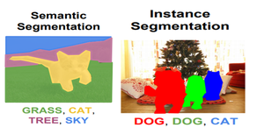

Slide 19
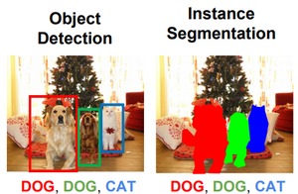

Slide 20
Applications:
The above-discussed object recognition techniques can be utilized in many fields such as:
Driver-less Cars: Object Recognition is used for detecting road signs, other vehicles, etc.
Medical Image Processing: Object Recognition and Image Processing techniques can help detect disease more accurately. Image segmentation helps to detect the shape of the defect present in the body . For Example, Google AI for breast cancer detection detects more accurately than doctors.
Surveillance and Security: such as Face Recognition, Object Tracking, Activity Recognition, etc.

Slide 21
How Object Detection Works
Object detection using machine learning involves the task of identifying and localizing objects within an image or a video. It goes beyond image classification by not only classifying objects but also providing their precise locations in the input data.
1. Data collection and annotation: A diverse dataset of images or videos is collected, and each object within the data is annotated with bounding boxes to indicate their locations and corresponding class labels.
2. Model training: Various machine learning techniques, including deep learning, are employed to train an object detection model. Convolutional Neural Networks (CNNs) are commonly used as the backbone architecture due to their ability to extract meaningful features from images.

Slide 22
How It Works
3. Network architecture: Object detection models typically consist of two main components: a backbone network and detection heads. The backbone network, often a pre-trained CNN like ResNet or VGG, extracts features from the input image. The detection heads are responsible for predicting bounding box coordinates and class labels.
4. Anchor generation: Anchors are predefined bounding boxes of different sizes and aspect ratios that are placed at various locations across the image. These anchors serve as reference frames for the model to detect and localize objects.

Slide 23
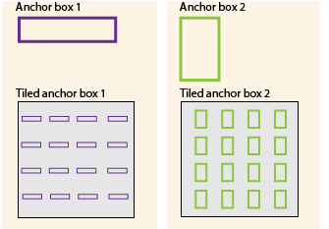

Slide 24
How It Works
5. Training process: During training, the model learns to adjust the predicted bounding boxes and class labels to match the ground truth annotations. This is done through an iterative process of forward and backward propagation, where the model's predictions are compared to the ground truth, and the model's parameters are updated to minimize the prediction errors.

Slide 25
How It Works
6. Inference and object detection: Once the model is trained, it can be used for object detection on new, unseen images or videos. The following steps are typically performed during inference:
a. Input image preparation: The input image is preprocessed, which may involve resizing, normalization, and other transformations.
b. Forward pass: The preprocessed image is fed into the trained model, which performs a forward pass through the network. The backbone network extracts features, and the detection heads predict bounding box coordinates and class probabilities.

Slide 26
How It Works
c. Post-processing: The predicted bounding boxes and class probabilities are processed to refine the detections. This step involves techniques such as non-maximum suppression (NMS) to eliminate redundant and overlapping detections and set confidence thresholds for accepting predictions.
d. Output: The final output includes the detected objects' class labels and their corresponding bounding box coordinates, allowing for their localization within the image.

Slide 27
Issues in Object Detection
Occlusion: Objects in an image or video may be partially or fully occluded by other objects or obstacles, making it challenging to accurately detect and localize them. Occlusion can lead to incomplete or inaccurate detections.
Scale variation: Objects can appear at different scales within an image or video. Detecting objects at various scales accurately is crucial but can be challenging, especially when dealing with small or large objects.
Object density: Images or scenes with a high density of objects pose difficulties for object detection algorithms. When objects are densely packed, distinguishing and localizing individual objects becomes more challenging, as they may overlap or share similar features.

Slide 28
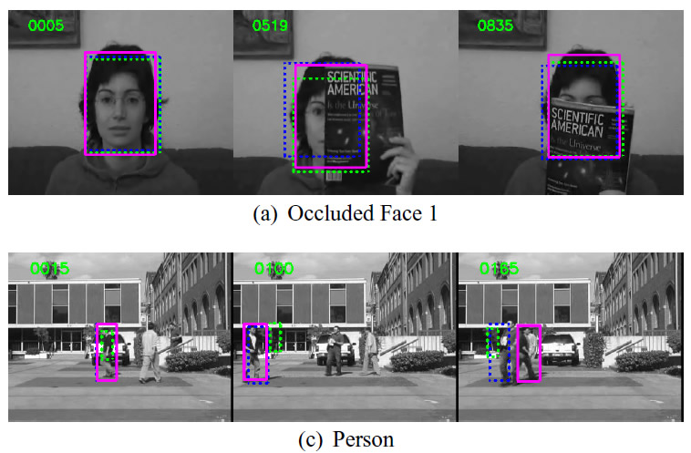
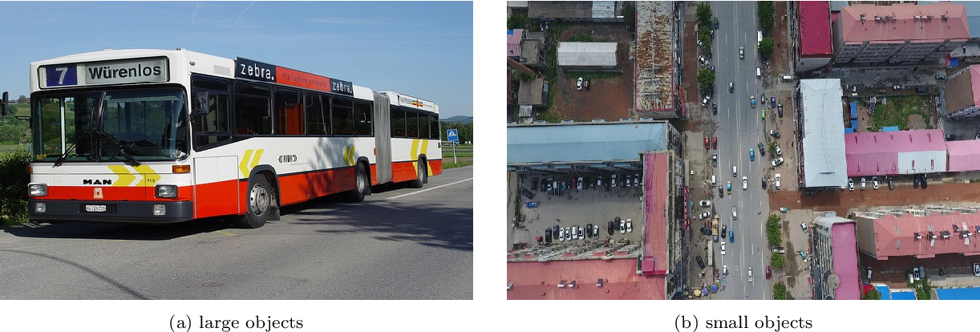

Slide 29
Issues in Object Detection
Background clutter: Objects of interest may be surrounded by complex or cluttered backgrounds, which can introduce noise and confusion for object detection algorithms. Background clutter can interfere with accurate object localization and increase false positive detections.
Generalization to unseen objects: Object detection models may face difficulties when detecting objects that differ significantly from the objects seen during training. They may struggle to generalize to novel or uncommon object classes or variations that were not adequately represented in the training data.

Slide 30
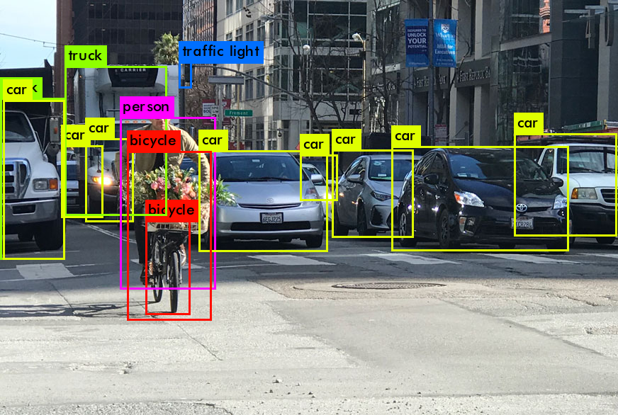

Slide 31
References:-
Books:-
"Introduction to Computer Vision" by David Forsyth and Jean Ponce. Chapter 6: Features and Descriptors provides an in-depth explanation of feature detection, extraction, and matching algorithms.
Computer Vision: Algorithms and Applications" by Richard Szeliski. Chapter 4: Image Features covers various feature detection, extraction, and matching techniques.
Video Links
"Feature Detection and Description" by Stanford University - Computer Vision (CS231n). Available on YouTube: https://www.youtube.com/watch?v=H-HVZJ7kGI0
"Feature Matching and Homography" by University of Washington - Computer Vision (CSE 576). Available on YouTube: https://www.youtube.com/watch?v=uvSCXyYpG9k
"Introduction to Feature Detection and Matching" by OpenCV. Available on YouTube: https://www.youtube.com/watch?v=AWoG8vdw4pA

Slide 32
THANK YOU
For queries
Email: payal.e12720@cumail.in

